Slide 2
Social Psychology and The Internet
Dr Lewis Goodings

Slide 4
Overview
Explore how social psychology typically understands Internet behaviour
Explore criticisms of early research on the Internet
Consider 2 pivotal issues in relation to social psychology and the Internet:
The Virtual Self
The Virtual Community
Look at the current issues in Facebook research
Discuss issues relating to methods and ethics in light of online communication

Slide 5
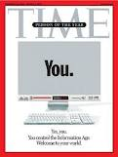
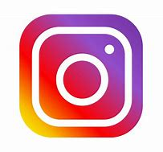
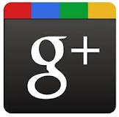
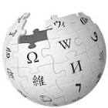
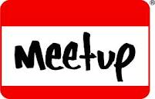
Social Networks

Slide 6
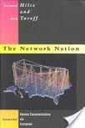
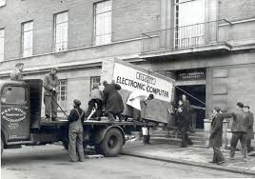
Hiltz & Turoff (1978)
The Network Nation
Based on extended study of ‘computer conferencing’
Pre-dated widespread use of PCs & internet
Envisaged generalised connectivity as the basis for society
Notes:
They were saying back then computer conferencing- (internet)
Set up networks and looked at colabrative working over it…got very excited by message baord envitronment…
They turned to Goffman to understand this not to trad psyc!
What is goffs intereaction order??

Slide 7
Social Presence Theory
Short, Williams and Christie (1976)
Deficit approach – CMC not as rich as FtF interaction
Social presence is communicated through visual cues, facial expressions, gestures and eye contact (none of which are present in CMC)
Degree of involvement of user in communication channel (e.g.‘Hot’ or ‘cold’)
CMC as ‘cold’
Notes:
Key is sense of immediate connection ---when we have it its great if not then its bad
So hot com---more soc presence.
Richness of interetiaon ---being in the moment—multiple sets of meanings..
So how do rate media on hot and cold– face to face is hot…vid conf..telephone..fax text.
Text would be seen as cold medium! But actualy its not!!! (modified and speed)
So there is a deabte here—texting might feel more drenched in soc pres than web cams…so ob or sub?

Slide 8
Cuelessness and Media Richness Model
Other deficit models
Rutter, 1987 – Cueless
Developed the social presence model and reiterated the importance of non-verbal cues
‘Psychological distance’ is increased in CMC settings
Daft & Lengel, 1984 – Media Richness
CMC genres like email cannot facilitate emotionally complex interactions
Nothing can compare with the detail, fluidity, intimacy and warmth of FtF interaction

Slide 9
Criticisms of the early models
They were models due to the fact that it was too early to actually know about the use of online technologies
Polarised the debate in terms of online and offline
Is communication online really that removed?

Slide 10
Social Information Processing Theory
Walther (1992)
Although CMC initially restricts emotionality, users develop creative means
Electronic paralanguage through language transformation e.g., emoticons ;-)
Strategic users can change the shape of the medium
Written vocalisations take on take new forms e.g. LOL
Notes:
Although narrow channel—we get creative about it..e.g.
Papr language- agl
Good users can do a lot of work with basic materials!!!
Curve from getting to know thru to intemate—
Can form quite intense rels on text coz of work investment…

Slide 11
Social Information Processing
Walther (1992: 69)
‘Given sufficient time and message exchanges for interpersonal impression formation and relational development to accrue, and all other things being equal, relational [quality] in later periods of CMC and FtF communication will be the same.’
Notes:
Interaction will start off restricted and then growing with emotion

Slide 12
Hyperpersonal Communication
Walther 1996
CMC can the even become a space for more friendly, social relationships
Walther and Parks (2002) – ‘Hyperpersonal’
Shared group membership can leave people feeling that they have more in common than they actually do (e.g. through an online group)
Visual anonymity means that participants may optimise their self-presentation
asynchronous communication can slow things down a little and enable people to compose things more thoughtfully and meaningfully

Slide 13
Warranting Principle
Walther and Parks (2002)
People who met online having first met offline
Information that the ‘target’ has no control over – e.g. information from their friends
The perceived validity of information presented online with respect to illuminating our offline characteristics.
People place most value in those cues that have a higher warranting value
The most salient other-generated cues are the wall postings on one’s profile page and the attractiveness of one’s friends.

Slide 14
Social Cognitive Approach
Walther et al., (2008)
Attractiveness of FB users
Fake FB profiles
High amount of wall posts and number of friends leads to a high ‘social’ attractiveness
Photos and other comments also contribute to ‘physical attractiveness’

Slide 15
Fake profiles

Slide 16
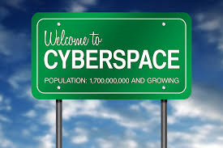
Group Dynamics in Cyberspace

Slide 17
The Virtual Self

Slide 18
Sherry Turkle
Multiple understanding of the self
Online settings give the opportunity to ‘re-invent ourselves’
“you can be whoever you want to be”
Aligns with a post-modern version of the ‘fragmented self’
Still feel a sense of unity through an ‘authentic’ version of the self (Turkle first trained as a psychoanalyst)
Online spaces as ‘identity workshops’

Slide 19
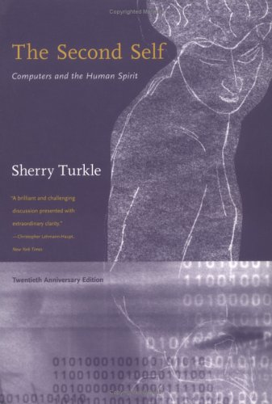
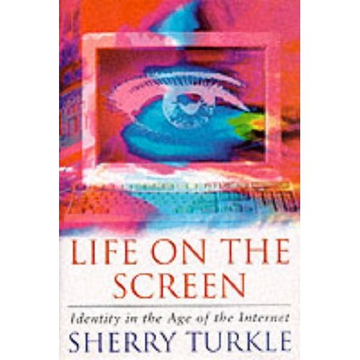
RL is just another window….

Slide 20
Turkle – Quote 1
In online communication…
‘You can be whoever you want to be. You can completely redefine yourself if you want. You don’t have to worry about the slots people put you in as much. They don’t look at your body and make assumptions. They don’t hear your accent and make assumptions. All they see are your words.’ (Turkle, 1995:184)

Slide 21
Turkle – Quote 2
‘As the boundaries erode between the real and the virtual, the animate and the inanimate, the unitary and the multiple self, the question becomes: Are we living life on the screen or in the screen?’ (1995:10)

Slide 22
Turkle (2011) – Alone Together
Develops ideas from Life on The Screen
‘In intimacy – new solitudes’
People spending more time using social media = more loneliness
Harper (2010) we both love and loathe our relationships with technology
Goodings (2011) closeness and distance

Slide 23
Goffman – Presentation of Self
Links to Goffman
Goffman (1969) – the physical structuring of a space has an impact on the way in which action and interaction are organised within it.
Impression management – front/back stage
Dramaturgical metaphor
Actors present themselves by using props and settings
Audience members distinguish between overt assumptions (‘given’) and the expressions an actor has less control over (‘given off’) to determine the actors authentic self

Slide 24
Goffman inspired research in Online Settings
Bargh, McKenna and Fitzsimmons, 2002 – true self
Davis, 2010 – personal interactive homepages
Robinson, 2007- the self-ing project
Siibak, 2009 – constructing masculinity
Whitty, 2008 – real me and the actual you

Slide 25
Challenges to this idea…
‘No matter how virtual the subject may become, there is always a body attached’ (Lupon, 2000)

Slide 26
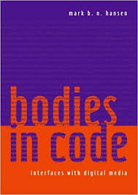
The Digital Body
Mark Hansen, Bodies in Code
It is through the body that we make sense of digital information
The body is the essential in the process of ‘enframing’ digital information - giving body to data.
Digital image - ‘entire process by which information is made perceivable through embodied experience’.
It looks at how information is made perceivable through embodied experience and framed to generate ‘corporeally apprehensible’ images.
Notes:
The body is performed in this mediation

Slide 27
The Virtual Community

Slide 28
Rheingold (1993)
Rheingold (1993) uses the term ‘virtual community’ to define his experience of the San Francisco based Whole Earth ‘lectronic Link (or WELL)
Virtual community as a reaction to the disappearance of informal public spaces
The Internet became a space in which to embrace the possibilities of post-modernity and transcend real world problems
Defined virtual communities in terms of personal relations as opposed to any other essential properties (shape, size etc.).

Slide 29
Imagined Audiences
Marwick & Boyd 2010
Embodied sense of felt connection that is shared across a network of other users
Social media collapse multiple audiences into a single context
Analysed 226 Twitter posts using the @reply function
‘The imagined audience affects how people tweet’
Twitter users have to balance personal authenticity and audience expectations

Slide 30
Mediated community
Linked to issues of place
Mediated in that they include:
a) dialectic of place and community
b) the mobilisation of symbolic resources
c) the maintenance of a collective history
d) the underwriting of personal identity in place identity
(Goodings et al., 2007)
Notes:
What is crucial is the relative degree of mediation

Slide 31
Digital memories
Hoskins (2009: 96)
‘Contemporary memory is thoroughly interpenetrated by a technological unconscious in that there occurs a co-evolution of memory and technology. Memory is readily and dynamically configured through our digital practices and the connectivity of our networks…The increasingly digital networking of memory not only functions in a continuous present but is also a distinctive shaper of a new mediatised age of memory’

Slide 32
Statistics (Facebook.com, 2010)
More than 500 million active users
50% of active users log on daily
over 700 billion minutes spent per month
over 900 million objects (pages, groups, events etc.)
Average user
has 130 friends
is connected to 80 community pages, groups and events
creates 90 pieces of content each month
More than 70 translations available
70% of Facebook users are outside the United States

Slide 33
Ellison, Steinfield, & Lampe (2007)
one of the earliest published articles
“Facebook Usage Intensity Questionnaire” later used by many others
268 undergrads (66% female, 44% male)
overwhelmingly used Facebook
to keep in touch with old friends
to maintain or intensify relationships characterized by some form of offline connection
Ellison, N. B., Steinfield, C., & Lampe, C. (2007). The benefits of facebook "friends:" social capital and college students' use of online social network sites. Journal of Computer-Mediated Communication, 12(4), 1143-1168.

Slide 34
Ellison, Steinfield, & Lampe (2007)
strong association between use of Facebook and bridging, not bonding, social capital
bonding social capital is between individuals in tight relationships, such as family and close friends
bridging is "weak ties," which are loose connections between individuals who may provide useful information or new perspectives for one another but typically not emotional support
Ellison, N. B., Steinfield, C., & Lampe, C. (2007). The benefits of facebook "friends:" social capital and college students' use of online social network sites. Journal of Computer-Mediated Communication, 12(4), 1143-1168.

Slide 35
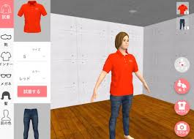
Methods and Ethics
Method:
‘Virtual ethnography’ - all comprise a growing number of new research methods that involve online interviews/focus groups, virtual tasks and just being online with the participants
Ethics:
Implications for informed consent, withdrawal and debrief procedures
BPS – Internet Mediated Research

Slide 36
Summary
The growing amount of Internet use prompts an opportunity to (re)explore how the self and community are understood
Self and community are clearly important social psychological concerns in terms of how we understand the use of the Internet
Growing amounts of research that utilise the Internet call for a deeper understand of methodological and ethical concerns

Slide 37
Reading
Barak, A. & Suler, J. (2008). Reflections on the Psychology and Social Science of Cyberspace. In A. Barack (Ed.) Psychological Aspects of Cyberspace. (pp. 1-13). Cambridge: Cambridge University Press.
Muise, A., Christofides, E. and Desmarasis, S. (2009). More Information than You Ever Wanted: Does Facebook bring Out the Green-Eyed Monster of Jealousy? Cyberpsychology and Behaviour, 12(4): 441-445.

