Slide 1
From Glad Rags to Fag-Hags: Consumer Behaviour and LGBT communities
Dr Daragh McDermott

Slide 2
Today’s Lecture
Lecture Outline
Consider some of the socio-cultural issues surrounding sexual minorities.
Examine data that indicates a change in attitudinal perceptions of sexual minorities.
Examine the concept of the ‘Pink-Pound’, assess its validity and consider its relation to identity and consumption
Examine the limitations of this concept and evaluate the extent to which it is generalizable.

Slide 3
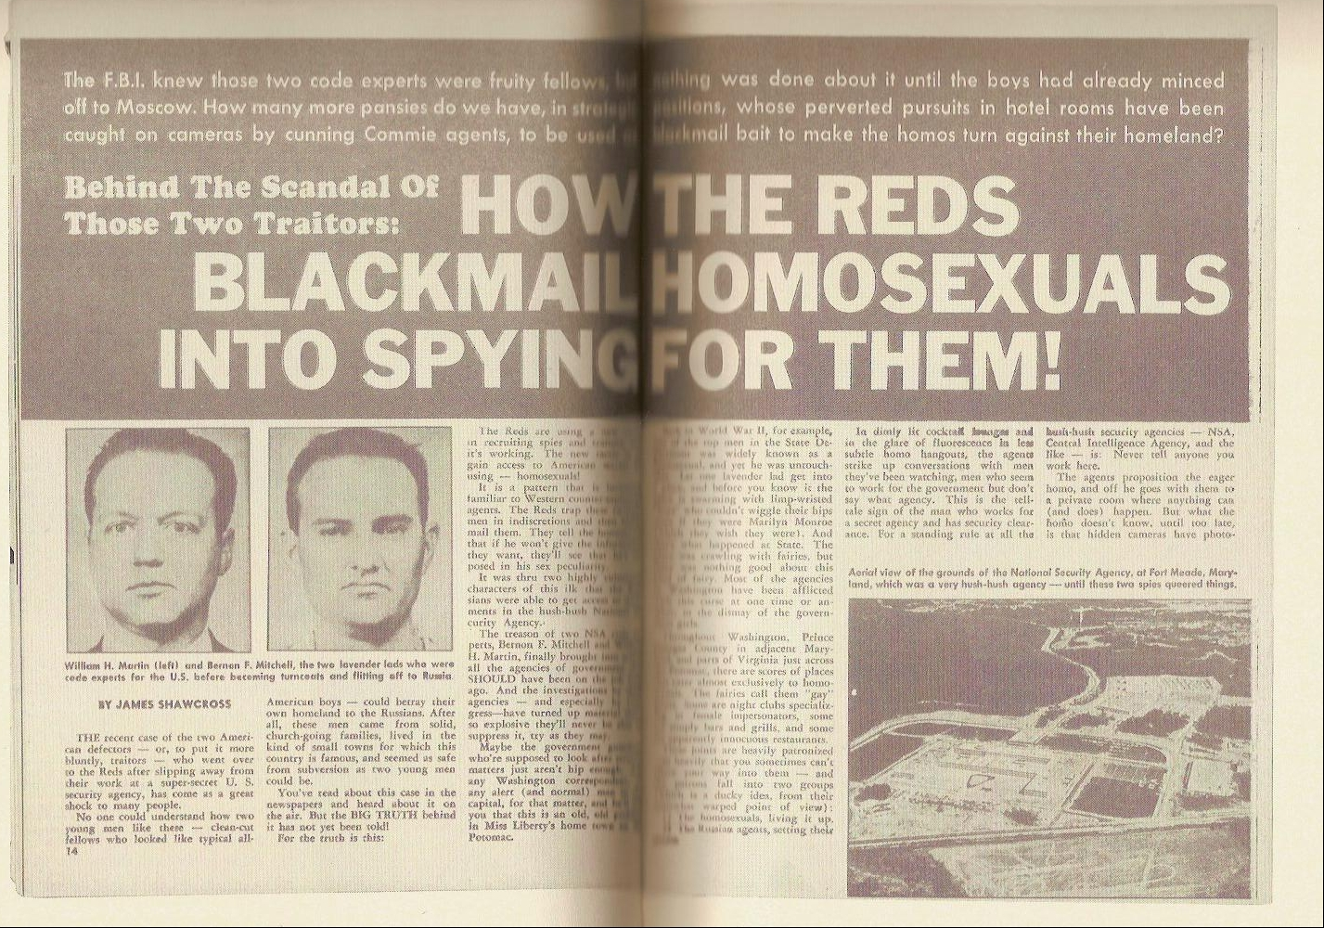
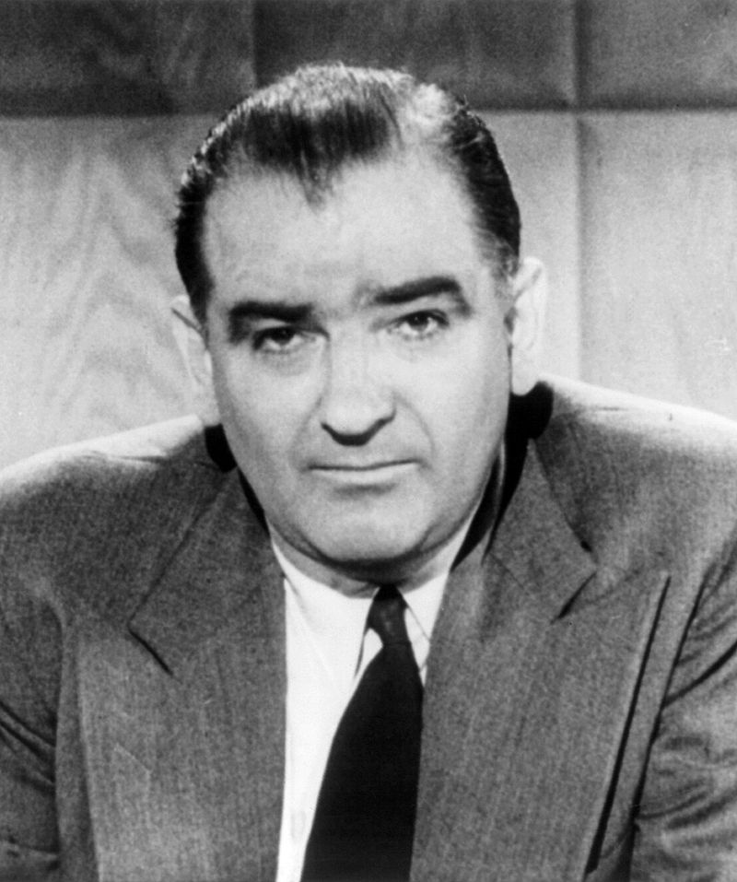
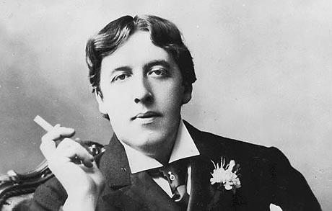
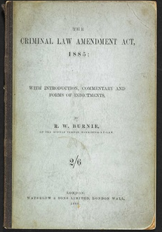
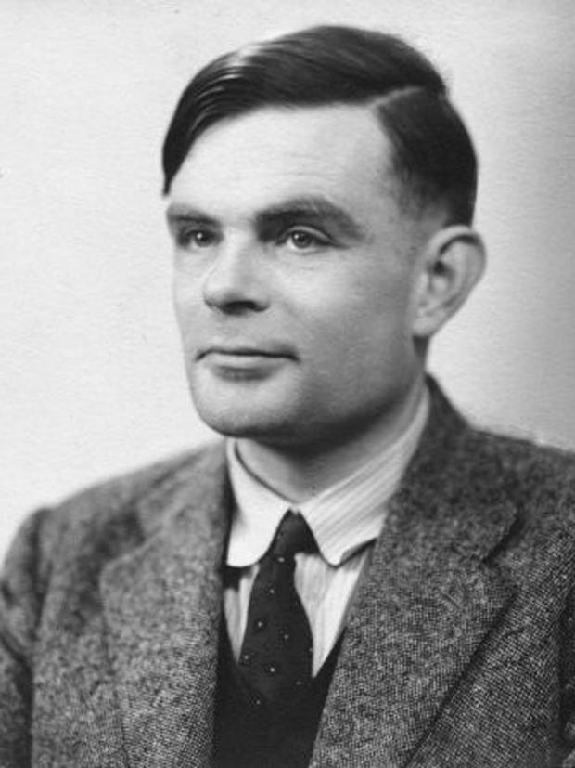
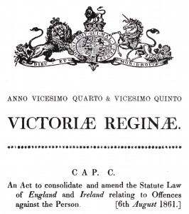
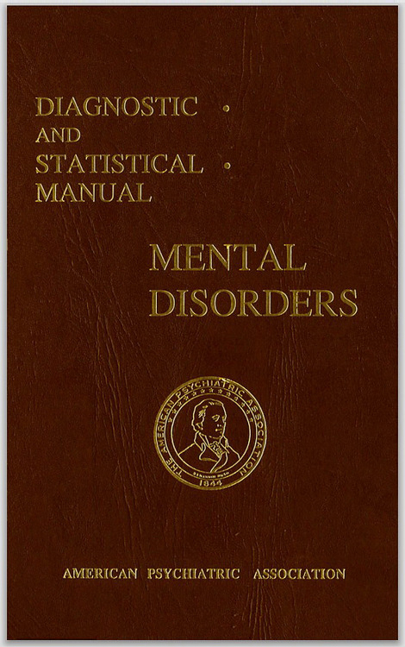
Sexual Minorities: A marginalised group
Notes:
We have come a long way, both in terms of societal beliefs about homosexuality and about gay men, but also in social psychology’s understanding of the prejudices gay men face. Our understanding of homosexuality and the factors that have influenced it have been driven by a range of factors both historical, political and cultural. The stigmatisation of homosexuality has been driven by key events, such as the passing of the Offences against the persons act and1861 and the Criminal Law Amendment Act 1885, and in particular the Labuchere ammendment which was sanctified by the trial of Oscar wilde and the the societal and political reaction to this. The existence of homosexuality, particularly in the UK has a mixed history after this point as gay groups tended to make some re-emergences over the intervening 80 years, however events such as the great war, the great recession and the second world war tempered any challenges or advances. In total, its recognised that ~49000 men were found guilty of gross indecency under the Criminal Law Ammendment act, one of the most famous being Alan Turing.
Such socio-political events helped embed anti gay sentiment into society at large and importantly, criminalised homosexuality across the entire British empire, countires of which included Ireland, much of Africa, Canada, India Australia and South Africa. In tandem, anti-gay sentiment was apparent, but not a focal point in the united states until the 1950’s and was primarily brought to the fore during the period known as McCarthyism where anticommunit rhetoric was associated with homosexuality. In tandem with these, the medical professions were increasingly interested in understanding the determinants of homosexuality and throughout the 19th and early 20th centuries an array of theories and hypotheses were forwarded to account for male and female homosexuality. The most prominent of these, at least initially, was the idea of sexual inversion, in which there were significant endocrinologucal and neurologuical differences between the heterosexual and homosexual brain. Most notably, there was little or no mention of it being a perversion. This all came later. The effect of which was homosexuality’s inclusion in the DSM Ii

Slide 4
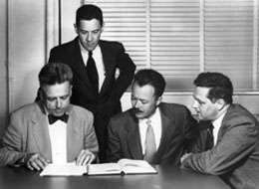
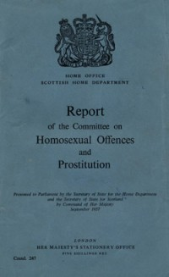
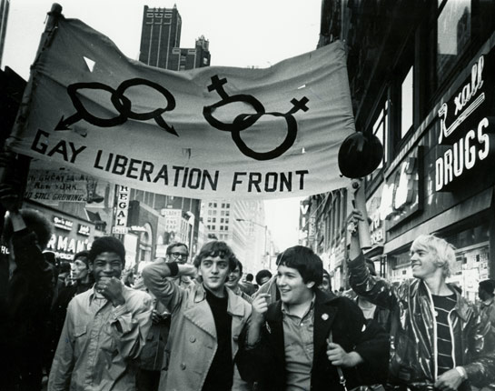
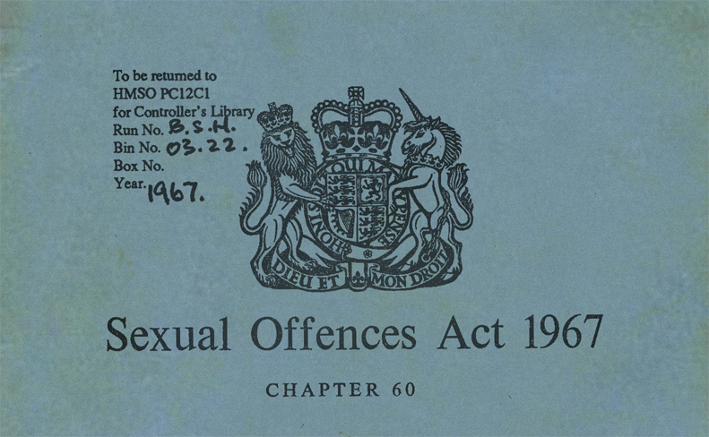
Kinsey, Martin, Pomeroy & Gebhard
Notes:
Through the 1960s and early 1970s, the tides began to change as new research began to dispel many of the myths and untruths about homosexuality and as groups in society began to seek increased civil rights and liberties (in the US and Canada). The

Slide 5
Then…

Slide 6
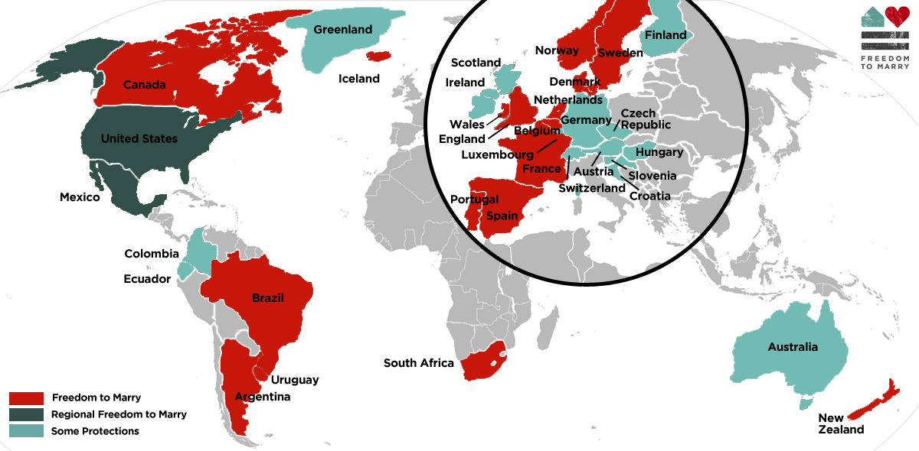
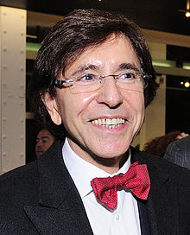
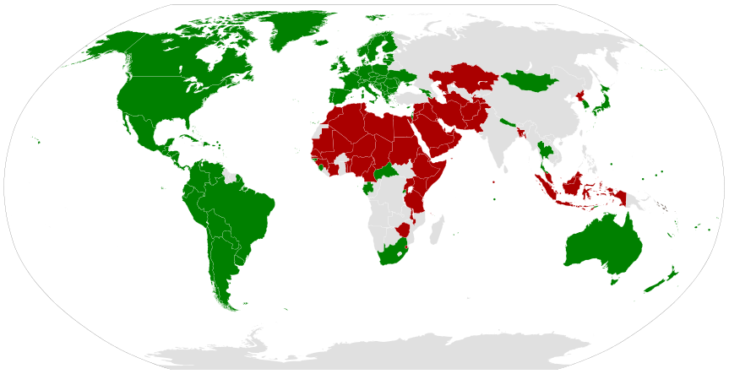
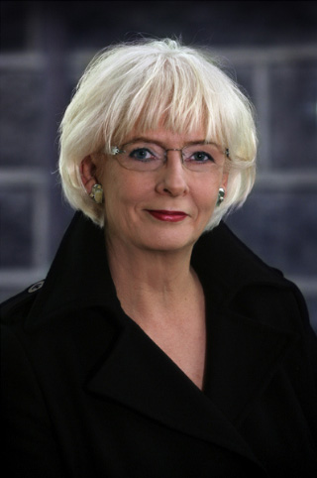
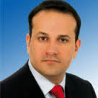
"LGBT marriage at the UN" Wikimedia Commons
"LGBT rights at the UN" Wikimedia Commons -

Slide 7
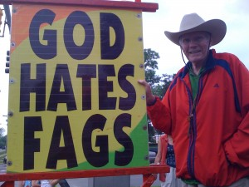
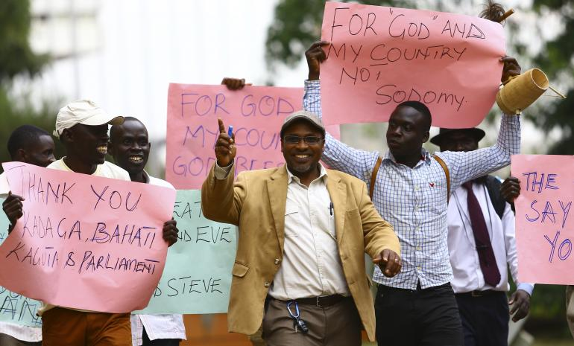
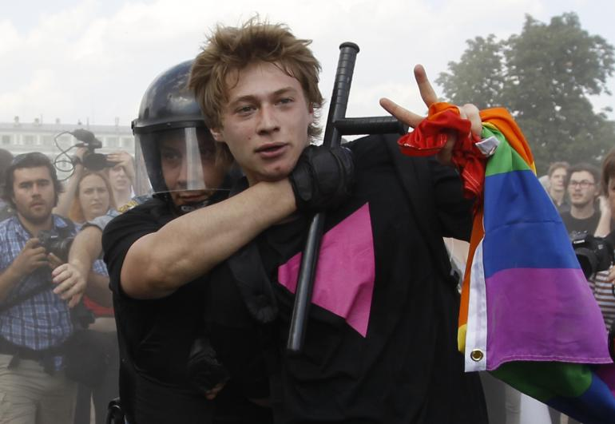
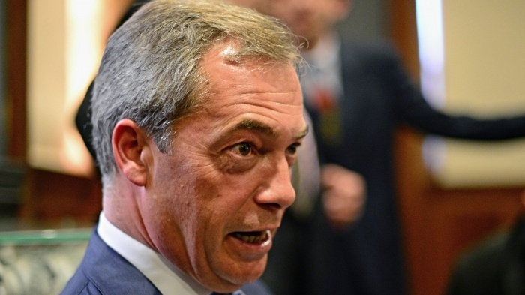

Slide 8
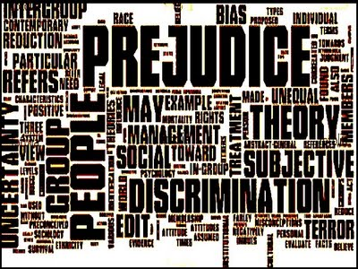

Slide 9
What term is most commonly associated with negative attitudes towards gay people?

Slide 10
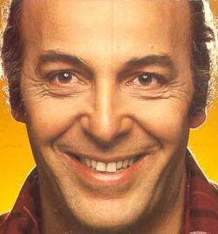
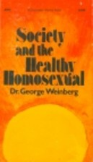
How do we define prejudice towards Sexual Minorities?
Homophobia (Weinberg, 1972)
The dread of being in close quarters with homosexuals.
Is related to a personal discomfort that heterosexuals may feel and report why associating with gay men and lesbian women (Raja & Stokes, 1998).
Is any reaction that does not value the homosexual lifestyle equally with the heterosexual lifestyle (Morin & Garfinkle ,1978).
These are all valid but is it really a phobia?

Slide 11
Homophobia (Weinberg, 1972)
Defined as:
is an irrational, intense, persistent fear of certain situations, objects, activities, or persons. The main symptom of this disorder is the excessive, unreasonable desire to avoid the feared subject (Boyd et al., 1990).
While this definition does hold some definitional value; strict interpretation of it does not full encapsulate prejudice directed towards sexual minorities.
Rarely are the actions of someone described as homophobic synonymous with the reactions of an apiphobe (fear of bees) or an agoraphobe (Rye & Meany, 2010).

Slide 12
Alternatives?
Heterosexism
Homonegativity
Sexual prejudice
Homophobia
Sexual Prejudice (Herek, 1984, 2000; 2004)
Prejudicial attitudes towards gay, lesbian, and bisexual individuals
Heterosexism (Lesbians respond, 1972)
The institutionalized oppression of gay and lesbian individuals based on the common belief that heterosexuality was superior.
Homonegativity (Hudson & Ricketts, 1980)
Prejudicial attitudes and affective responses of heterosexuals towards homosexuals
Re-defined to include beliefs, affective and behavioural responses towards homosexuals

Slide 13
Morrison & Morrison (2003)
Homonegativity
Modern Homonegativity
Abstract legal concerns
Illegitimate changes to status quo
Old-Fashioned Homonegativity
Biblical injunctions
Pathologising homosexuality
Supposed
eradication of discrimination
Exaggeration of one’s sexual orientation
Tested the relationship between measures of old-fashioned homonegativity (i.e., ATLG; Herek, 1994) and modern homonegativity (i.e., MHS-G)
ATG scores tended to demonstrate floor effects
Scores on the MHS significantly higher than ATG
(Morrison & Morrison, 2003)
Notes:
Caution the point that Herek found different results with his national probability data
Old-fashioned prejudice is overt in nature.
It is rooted in religious and moral beliefs
It is also rooted in common, inaccurate misconceptions
Modern prejudice is more covert in nature
Reflects beliefs that certain groups are pushing too hard for undeserved gains in society
Reflects beliefs that prejudice is largely a thing of the past

Slide 14
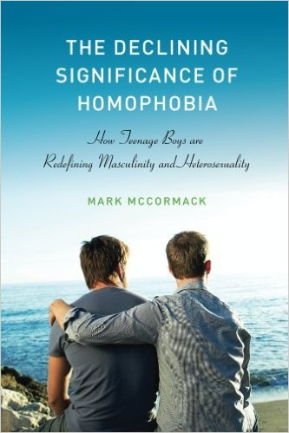
Have things imporved?
Research Evidence:
Twenge, Sherman, and Wells (2016) – Considerable decrease in self-reported disapproval of homosexuality in North America between 1973-2014.
Andersen and Fetner (2008) – Decrease in self-reported disapproval of homosexuality in Canada between 1981 – 2000.
McCormack (2013) – English schools/sixth-forms are no longer hostile environments for LGBT youth. People take pride in their gay-affirmative attitudes

Slide 15
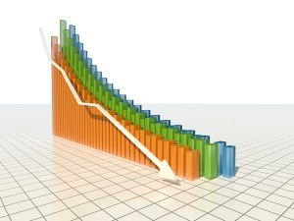
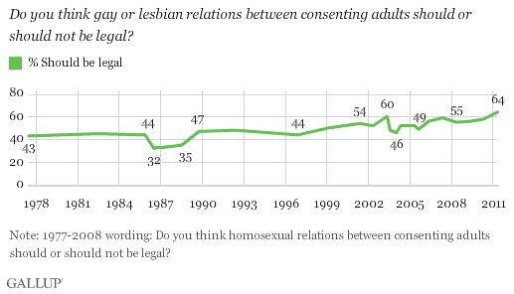
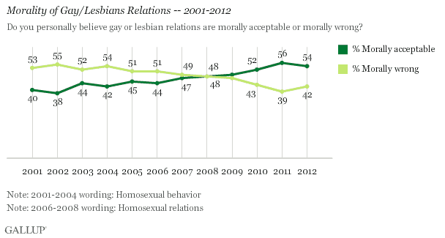
Attitudinal data
American and Canadian researchers provided data indicating an amelioration in prejudice towards sexual minorities (in its various guises):
For example, Balanko (1998) and Simon (1995) reported a downward trend in self-reported scores on the ATLG (Herek, 1994).
Baunach (2010) reports on a reversal in same-sex marriage attitudes from being omnipresent in 1988 to being geographically localised and directly influenced by key variables (e.g., being evangelical Christian) in 2010.
Notes:
Caution the point that Herek found different results with his national probability data

Slide 16
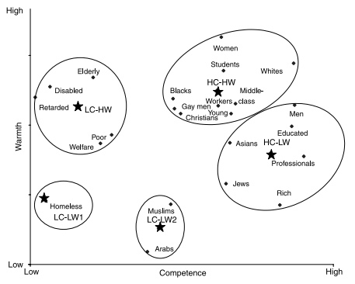
Stereotype Content (Cuddy et al., 2009)

Slide 17
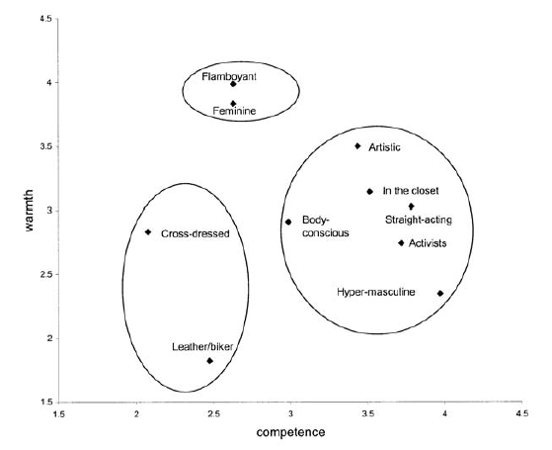
Bias Map (Cuddy, Fiske, & Glick, 2007)

Slide 18
Have things improved?

Slide 19
Ambivalent Homoprejudice Theory
Brooks et al., (Submitted)
Romanticised Homoprejudice: a benevolent component characterised by the idealisation of gay men based on prevailing stereotypes
Adversarial Homoprejudice:
envious beliefs that gay men receive undeserved privileges as compared to heterosexuals
Envy
Benevolent
Pity
Hostile
Paternalistic homoprejudice, stifling and overbearingly sensitive attitudes make gay men feel belittled, demeaned, and infantilised
Repellent Homoprejudice
which expresses contempt, disgust, and moral indignation towards gay men

Slide 20
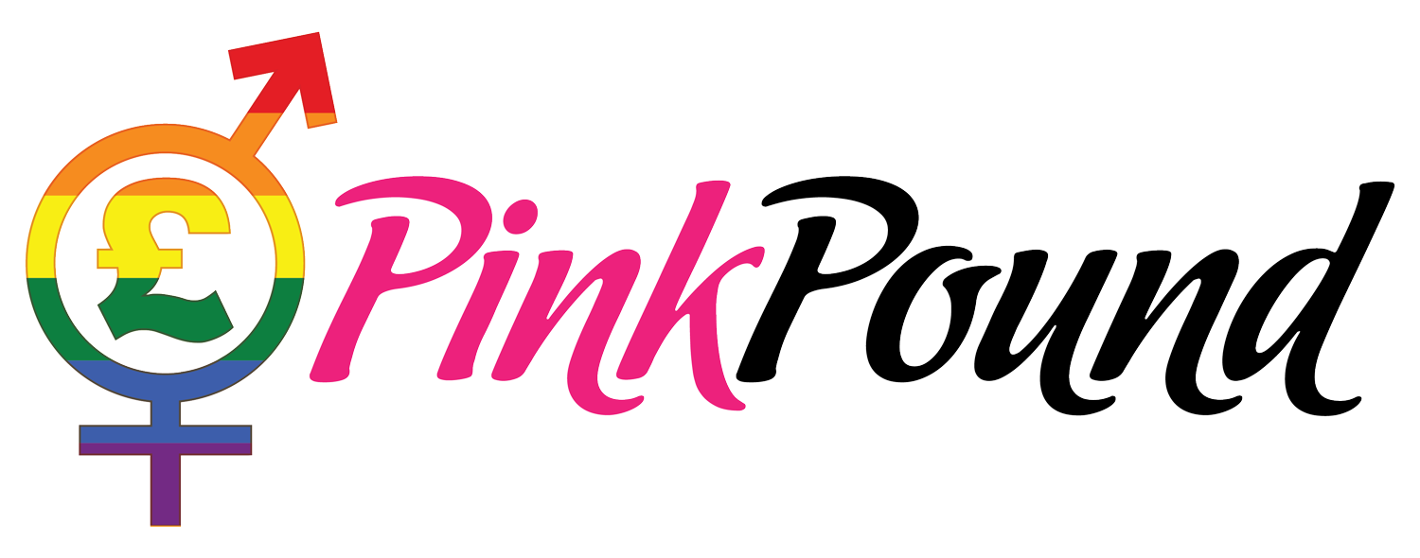
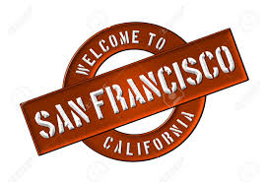
The Pink Pound
What is it?
The belief that LGBT people and households are prosperous, with an extensive disposable income which allows them to afford an abundant range of luxuries, often referred to in the UK as the “pink pound” (Matthews & Besemer, 2015).
An associated concept is that applied to the gentrification of urban areas by predominantly same-sex oriented individuals, colloquially referred to as ‘gaybourhoods’.

Slide 21
Beveridge (2015; FT)
The Pink Pound
Estimated to be worth £6 Billion per annum to the British economy
Reinforced by the DINK acronym (Double Income/No Kids)
Lack of clarity as to the actual size of this market
Generalised figure of 1:10 identify as LGB
Official ONS statistics suggest a figure closer to 1.7% (N = 150,000)

Slide 22
The Pink Pound
What is it?
The belief that LGBT people and households are prosperous, with an extensive disposable income which allows them to afford an abundant range of luxuries, often referred to in the UK as the “pink pound” (Matthews & Besemer, 2015).
An associated concept is that applied to the gentrification of urban areas by predominantly same-sex oriented individuals, colloquially referred to as ‘gaybourhoods’.

Slide 23
The Pink Pound
A significant market?
Companies and manufacturers have acknowledged the potential opportunities that exist in targeting sexual minority consumers.
As a product target, they offer a niche sector of consumers for whom certain products are desirable and advertisements can be aimed at, purely on the basis of their sexual orientation identity.

Slide 24
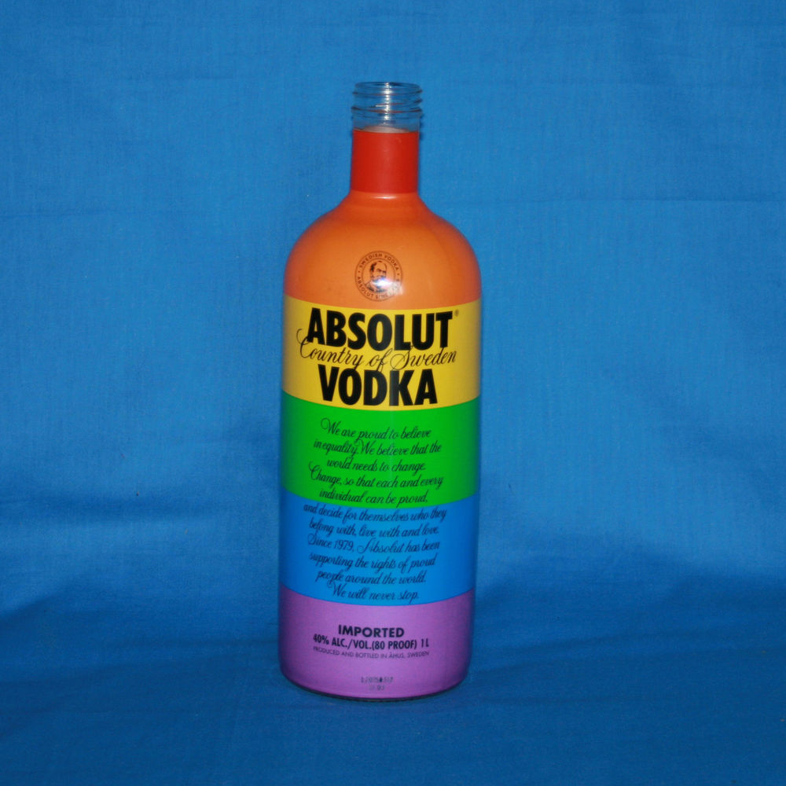
Consumer Examples

Slide 25
The Pink Pound
Research evidence:
Fugate (1993) contended that the gay and lesbian market did not present a commercially viable market segment.
Enaloza (1996) asserts that the gay and lesbian market is indeed worthwhile. Moreover, she delineates the significance of exploring the relationship of the gay and lesbian market and the gay-rights social movement.
The question at this juncture is why?

Slide 26
The Pink Pound
Enazola (1996)
Incorporation of sexual minority communities in advertising serves to legitimise and democratise sexual minorities through market incorporation.
Facilitates the progression of full accommodation of the gay and lesbian community in other social and political institutions.
An applied aspect of the ‘parasocial contact hypothesis’ (Schiappa et al., 2004)

Slide 27
The Pink Pound
Is inclusion of sexual minorities in advertising a new trend?
Branchik (2002) argues that advertisers have been attempting to tap into this market since the launce of marketing and advertising
The underground phase (pre-1941)
The community building phase (1942 – 1970’s)
The mainstream phase (1970’s – present)

Slide 28
The Pink Pound
Ginder & Byun, (2015):
Underground phase
Associated with urbanization, the industrial revolution, and the migration of gay men to larger cities
Community building phase
Driven by the establishment of gay-friendly communities and businesses, and the Stonewall riots that launched the modern gay-rights movement.
Mainstream phase
Marked by the gay-rights movement, sexual revolution, and acceptance of the gay consumer market into the mainstream consumer economy

Slide 29
Types of Advertisements
Targeted Recognition
Earliest advertising that targeted the gay community more implicitly by primarily featuring discreet gay imagery and discourse.
Ridicule/scorn
General sense of social conservatism, gay men were targets of social stigmatization.
Cutting edge
Depict gay men as fashion-forward and sophisticated, with an increasing emphasis on shocking imagery and more blatant homoeroticism
Respect
Has emerged within which gay men are represented in a variety of roles and positions

Slide 30
Advertising Examples

Slide 31
The Pink Pound
Issues with advertising campaigns:
Campaigns risk alienating ‘mainstream consumers’ (Oakenfell & Greenlee, 2005).
Campaigns have been criticized for the application of inaccurate stereotypes and representations of sexual minority consumers (Pavel, 2014).
Marketing and media targeting and featuring gays and lesbians attempt to heteronormalize the public image of gayness for mass, mainstream consumption.

Slide 32
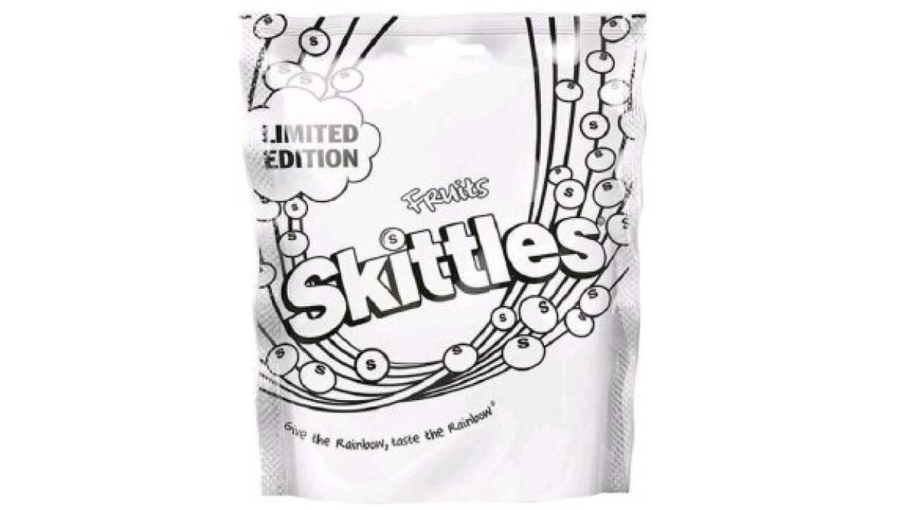
Thoughts

Slide 33
Thoughts?

Slide 34
A ‘gay’ market?
Questions need to be asked about the ‘ubiquity’ of a gay market
Is there a single template for a gay consumer?
Do advertisers seek only to target an idealised (heterosexualised) version of sexual minorities?
Does the normalisation of gay consumers serve to alienate wider aspects of sexual minority communities?

Slide 35
A ‘gay’ workforce?

Slide 36
Risks for brands and marketers
Oakenfull and Greenlee (2005)
Investigated the influence of different forms of ad imagery (e.g., mainstream heterosexual, explicit/implicit sexual minority subcultural symbolism).
Findings:
Heterosexual participants had a more positive attitude toward heterosexual imagery than the explicit gay male or explicit lesbian imagery.
Implicit (but identifiable) gay and lesbian imagery and iconography appealed to both heterosexual and homosexual consumers

Slide 37
Risks for brands and marketers
Contradictions:
Bradley (2010) who found that heterosexual participants reported negative feelings and less arousal as a result of viewing an ad featuring homosexual imagery as opposed to heterosexual imagery.
This contributed to a more negative attitude toward the ad.
Angelini & Bradley (2010) found that participants viewed ads with homosexual imagery longer than ads with heterosexual imagery and subsequently more freely recalled, recognized, and encoded in memory the imagery.

Slide 38
Risks for brands and marketers
Risks:
Brands and products risk being marginalised as being ‘gay products’.
Risks of products being classed as engaging in ‘pinkwashing’.
Target products in the United States
Target Will Gladly Take Your Gay Money But Won't Support Your Equal Right to Gay Marry

Slide 39
The fallacy of the Pink Pound?
The myth of ‘Gay Affluence’ (Badgeet, 1998)
The assumption that sexual minorities have a greater disposable income is not as straightforward as is suggested.
The economic status between heterosexuals and sexual minorities is actually quite complex (Hettinger & Vandello, 2014).
Incomes in gay and lesbian households may actually be lower than comparable heterosexual households (Romero, et al., 2007).

Slide 40
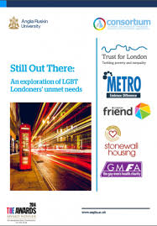
The fallacy of the Pink Pound?
McDermott & Luyt (2016)
In an analysis of LGBT Londoner’s, evidence demonstrated that levels of poverty among sexual minorities was markedly high.
Sexual minorities also faced distinct pressures in trying to live up to stereotypical ideals and expectations.
Despite anti-discrimination legislation, still face distinct economic challenges.

Slide 41
The fallacy of the Pink Pound?
Drydakis (2015)
Conducted a field experiment in which CV’s were sent to prospective employers in the UK (144 jobseekers and their correspondence with 5549 firms)
Results demonstrated that the probability of gay or lesbian applicants receiving an invitation for an interview was 5.0 percent (5.1%) lower than that for heterosexual male or female applicants.

Slide 42
In conclusion
Today’s lecture
Considered some of the contextual issues surrounding sexual minorities.
Examined data that indicates a change in socio-cultural perceptions of sexual minorities.
Examined the concept of the ‘Pink-Pound’, assess its validity and consider its relation to identity and consumption
Examined the limitations of this concept and evaluated the extent to which it is generalizable.

Slide 43
In conclusion
Take home message
In order to understand the consumption in relation to sexual minority consumers, one must understand the distinct historical and socio-political contexts.
Companies have identified sexual minorities as a target market and are actively seeking to sell to this market
While this market is lucrative, the degree to which it is as powerful as it assumed is questionable.

