Slide 1
Consumer Research
Dr Suzanna Forwood
Suzanna.Forwood@aru.ac.uk

Slide 2
Learning objectives
Outline common techniques used to investigate consumer behaviour and attitudes.
Critically examine the different methods for accurately measuring behaviour and changes
  intention vs behaviour,
  manipulations in stores and controlling for variables
  conjoint analysis and other lab methods.
Demonstrate an understanding of population approaches to consumer behavioural change within psychology

Slide 3
What products do people prefer or purchase?
How can we change these with a campaign, advert, promotion etc?
Public Health
Marketing and Business
Consumer Psychology
Psychology
Economics

Slide 4
Exploring consumer behaviour

Slide 5
Two Key questions
What products do people prefer or purchase (i.e. stated and expressed preferences)?
To what extent does exposure to a campaign, advert, promotion etc alter these attitudes or behaviours

Slide 6
Methods
Behaviour
  Purchase – real world and messy
  Discrete choice – controlled choice scenario
  Decision making – lab test of preference
Self-report pre-cursors
  Preference
  Attention
Implicit pre-cursors
  Eye tracking
  Attentional Bias
Behaviour is hard to measure. Therefore, reported attitudes or purchase intentions (stated preferences) are used as a proxy for purchase behaviour (expressed preferences).

Slide 7
Theme 1: context matters
Who takes part in a study,
where the study is performed and
how ‘real’ the behaviour all impact on the findings…
… and the generalisability of the findings.

Slide 8
Study 1: Displaying food for promotion of public health
Choice from a limited range of option
Participants are self-selecting
Desire to see what works

Slide 9
Public Health

Slide 12
Study 2: What is the impact of displaying options?
Lab study
Tight control of all the options
Eye-tracker data
Multiple levels of outcome (from just noting it to choice).

Slide 13
Psychology

Slide 16
Study 3: How does this impact in real-world food choices?
Real-world choices
Shop-level data, not individual-level
Multiple additional variables that are hard to control

Slide 17
Marketing and Business

Slide 20
Lab studies, limited choices, participants identifying with the study objectives all increase the sizes of effects seen
Real world behaviour is messier and effects are much harder to see and often smaller.

Slide 21
Theme 2: a cautionary tale preferences
While measuring attitudes is common and tempting, there are pitfalls…

Slide 22
Study 4: Preferences are not fixed
Pit different attributes against each other using Conjoint Analysis
Test participants under different conditions.

Slide 23
Psychology

Slide 24
Method
Pairs of snack options, varying in three attributes
  Taste: liked vs disliked
  Portion size: large vs small
  Waiting time: now vs in 90 mins
e.g.
Liked-small-90 mins VS Disliked-small-now
Tested under two motivational states
  After lunch or 15 hour fast.

Slide 25
Preferences are relative to the other options and context-sensitive

Slide 26
Study 5: Preferences can be poor predictors of behaviour
Choices have value and status
Some choices and preferences are socially unacceptable

Slide 27
Marketing and Business

Slide 30
vs OR vs
ARTICLES
Special:
Swimsuits
ARTICLES
Special:
Top 10 Athletes
SPORTS
Special:
Top 10 Athletes
SPORTS
Special:
Swimsuits

Slide 31
Stated preferences are social actions, and are therefore not immune to conventions around social acceptability.

Slide 32
Two key questions
Are you interested in what products people prefer OR in what products they purchase (i.e. stated and expressed preferences)?
Are you interested in whether exposure to a campaign, advert, promotion etc alters people’s attitudes/ knowledge/ beliefs OR people’s behaviour?

Slide 33
Chance, Z. & Norton, M., 2009. “I Read Playboy for the Article”: Justifying and Rationalizing Questionable Preferences. Available at: http://www1.hbs.edu/research/pdf/10-018.pdf [Accessed July 18, 2012].
Chandon, P. et al., 2009. Does In-Store Marketing Work ? Effects of the Number and Position of Shelf Facings on Brand Attention. , 73(November), pp.1–17.
Hoefling, A. & Strack, F., 2010. Hunger induced changes in food choice. When beggars cannot be choosers even if they are allowed to choose. Appetite, 54(3), pp.603–6. Available at: http://www.ncbi.nlm.nih.gov/pubmed/20206216 [Accessed August 31, 2015].
Van Kleef, E. et al., 2012. Healthy snacks at the checkout counter: A lab and field study on the impact of shelf arrangement and assortment structure on consumer choices. BMC Public Health, 12. Available at: http://www.biomedcentral.com/1471-2458/12/1072 [Accessed March 31, 2017].
Sigurdsson, V., Engilbertsson, H. & Foxall, G., Journal of Organizational Behavior The Effects of a Point-of-Purchase Display on Relative Sales : An In-Store Experimental Evaluation The Effects of a Point-of-Purchase Display on Relative Sales : An In-Store Experimental. , (July 2013), pp.37–41.

Slide 34

Psychology of changing behaviour
Notes:
Good afternoon everyone
Welcome to lecture 19.

Slide 35
Key question
Population behaviour change – what do we know from psychology about changing behaviour?

Slide 36
Approaches to population intervention
Mass media campaigns (Morrison and Benner 2009)
  Education and information
  Refining communication
  Fear
  Specific targeting to populations
Nudges and low-agency interventions (Adams et al 2016)
  Environmental influences
  Low Agency

Slide 37
Mass Media Campaigns
Early media campaigns & the ‘hypodermic model of change’ (McGuire et al, 1985)
  Rationality
  Persuasion
  Convincing source

Slide 38
Mass Media Campaigns
Examples
Diet
https://www.youtube.com/watch?v=Nb0fLYdPEPM&t=1s
Stroke symptoms
https://www.youtube.com/watch?v=O3F-r0D648o

Slide 39
Mass Media Campaigns
Do they work?
Media campaigns can raise awareness (Stead et al 2002)
Most effective when part of a multi-modal intervention (Wakefield et al, 2010).
Cumulative effect of repeated media campaigns on knowledge, behaviour and attitudes (Bala et al, 2008)
There is an impact on awareness of the campaign, knowledge and attitudes.

Slide 40
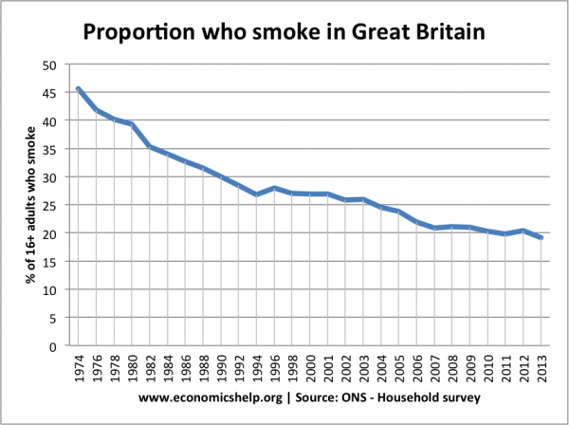
Mass Media Campaigns
Do they work?
18-month long British anti-smoking campaign > 1.2% reduction in smoking levels (McVey & Stapleton, 2000)
Change4Life evaluation showed increased awareness, but little impact on attitudes or behavior. (Croker et al, 2012)
Difficult to see effects of the campaign vs other trends
Not always effective

Slide 41
Mass Media Campaigns: Elaboration Likelihood Model (ELM)
Elaboration Likelihood Model (ELM) (Petty & Cacioppo, 1986): a behaviour change model that provides a framework for refining campaigns, states that response to campaigns depends on:
Pre-existing beliefs + Personal motivation + Capacity to understand
  If someone has congruent beliefs with the campaign, strong motivation and good intellectual ability to process the information, the campaign is likely to be effective.
  If someone has incongruent beliefs with the campaign, weak motivation and poor intellectual ability to process the information, the campaign is less reliable.

Slide 42
Mass Media Campaigns: Elaboration Likelihood Model (ELM)
congruent beliefs with the campaign + strong motivation + good intellectual ability to process the information
> via central route
incongruent beliefs with the campaign + weak motivation + poor intellectual ability to process the information
> via peripheral route

Slide 43
Mass Media Campaigns: Elaboration Likelihood Model (ELM)
Refinements to optimise the Peripheral route
Credibility of source
Emotion of message
Relevance of the people/places/activities portrayed
Use all of these to maximise impact of the peripheral and impact on those with incongruent beliefs with the campaign, weak motivation and poor intellectual ability to process the information, who are less likely to respond to the information in the campaign.

Slide 44
Mass Media Campaigns: Fear
Negative emotion is accompanied by high level of arousal
Lots of research in the 1950s to 1970s
Can distinguish emotional and cognitive aspects (Ruiter, Abraham and Kok 2001)
Fear and other negative emotions can work

Slide 45
Mass Media Campaigns: Fear
Examples
Smoking
https://www.youtube.com/watch?v=K9NTmAFQvfs
https://www.youtube.com/watch?v=ef3gofQcOKk
Alcohol
https://www.youtube.com/watch?v=mo_49X7B53o
Drink Driving
https://www.youtube.com/watch?v=TEVbSB2vz_8

Slide 46
Mass Media Campaigns: Fear
Does it work?
Low threat fear appeals don’t have much effect
Use of other emotions: disgust, anger, sadness, irritation, anxiety, depression (Dillard et al 1996)
Can be effective when
  The threat is significant and relevant
  The response is easy
  The response reduces fear
  (Soames & Job 1988; Witte & Allen, 2000)

Slide 47
Mass Media Campaigns: Fear
Does it work?
Early attempts were targeted at whole populations
E.g. HIV - campaigns to promote healthier sexual behaviour
  Targeting at whole population: high risk sexually active gay men and lower risk non-sexually active or older people.
  Fear message
Resulted in
  Fear response in groups with very low risk of HIV/AIDS
  Fear not made relevant for high risk groups, and response less appropriate for those groups.

Slide 48
Mass Media Campaigns: Relevance
Target message to a population
  Situation
  Fear/humour
  Imagery
  Response

Slide 49
Mass Media Campaigns: Relevance
Ensure message is appropriate for a broad audience
  Situation
  Fear/humour
  Imagery
  Response
One you
https://www.youtube.com/watch?v=IUFXxHiyNqE
Inching towards bad health
https://www.youtube.com/watch?v=3uey7q3eoXs

Slide 50
Prevention at the population level
Geoffrey Rose (1985)
Epidemiologist
How to target medical interventions to reduce the burden of disease?
Traditionally doctors target individuals
  Requires time and cost
  Target only those with known risk
  Visible impact on individual
  Medicalization of risk factors
Rose led a shift in outlook away from individual-level and towards population-level approaches.

Slide 51
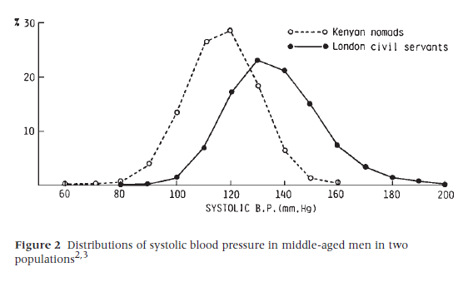
Prevention at the population level
Geoffrey Rose (1985)
“A large number of people at a small risk may give rise to more cases of disease than the small number who are at high risk”
It is easier/cheaper to prevent illness by changing behaviour in the whole population, rather than targeting small ‘high risk’ groups

Slide 52
Prevention at the population level
Adams, Mytton, White & Monsivais (2016)
Another dimension to Rose’s population-level outlook.
Public information campaigns (e.g. Change4Life) “that focus on providing advice, guidance, and encouragement rely heavily on individuals being able and motivated to engage with this advice.”
“The effectiveness and equity of these interventions has been questioned.”
For example: interventions to promote folic acid intake:
High agency: leaflet promoting folic acid supplements
Low agency: Add folic acid in bread at manufacture

Slide 53
Prevention at the population level
Requiring agency reinforces SES disparities
  Need for cognitive resources
  Need for time or money
  Need for health literacy to understand leaflet
  Need for more strategies to succeed
  Need for all of these

Slide 54
Prevention at the population level
Population Community Individual

Slide 55
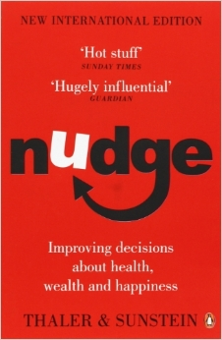
Nudging: Choice architecture
The decisions you make are moulded by the environment or place in which you make them.
Key aspects of the Environment can be changed to make you more or less likely to make certain choices.
How the environment is structure is called choice architecture

Slide 56
Nudging: Choice architecture
Factors include:
Defaults
Framing/referencing
Choice over time
Social Norms
Partitioning or aggregating options of attributes
Proximity/availability
Low need for agency
Low need for cognition

Slide 57
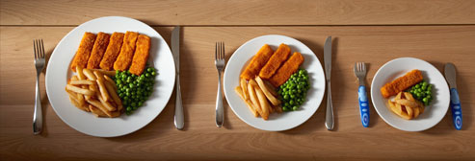
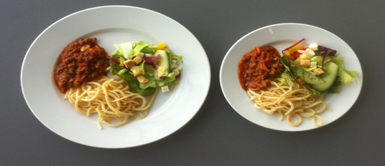
Nudge: Portion Size
Gives an indication of the social norm for food quantity to eat.
Portion
Tableware

Slide 58
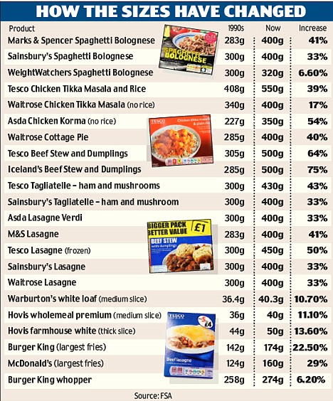
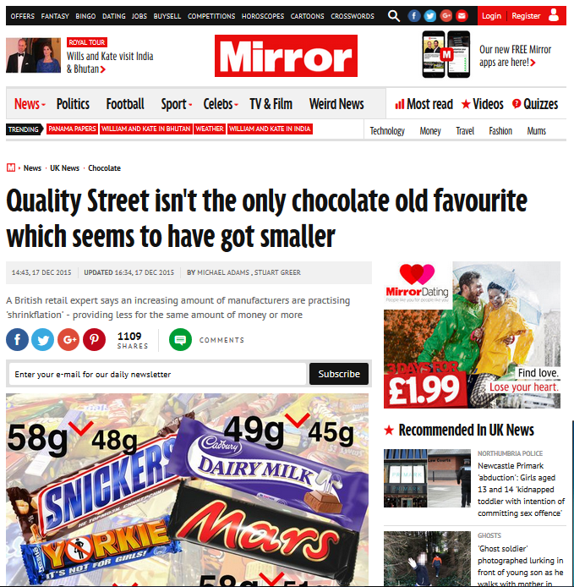
Nudge: Portion Size
Packaging
Historical increase vs Recent public health decrease
http://webarchive.nationalarchives.gov.uk/20120206100416/http://food.gov.uk/multimedia/pdfs/reviewportions.pdf
http://www.mirror.co.uk/news/uk-news/quality-street-isnt-only-chocolate-5084729

Slide 59
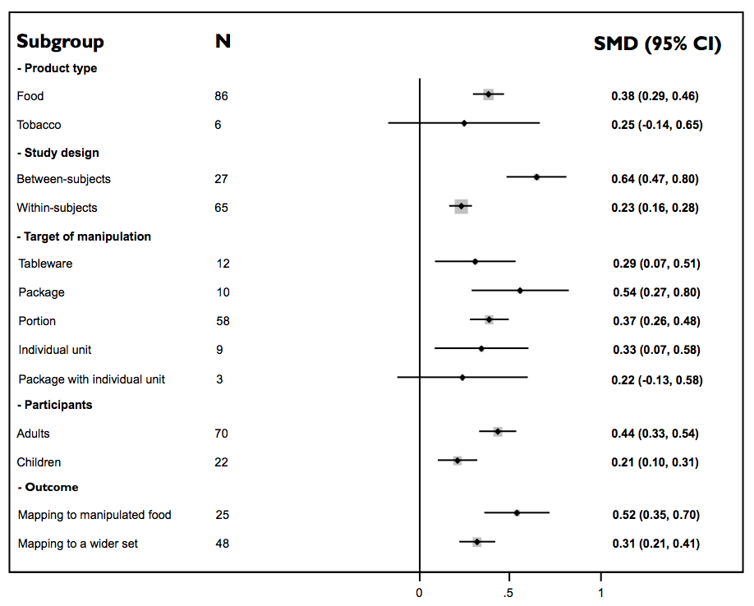
Nudge: Portion Size
Systematic review of studies shows that larger portions, packaging and table-ware increases the amount of food eaten (Hollands et al, 2015)

Slide 60
Nudging: Choice architecture
Portion size interventions are effective at changing the amount of food eaten
Who is responsible for portion sizes/tableware/packaging?
  Food manufacturers
  Food vendors – restaurants, canteens
  Individuals when preparing food at home.
How could a public health intervention change portion sizes?
  Legislation/regulation
  Public health incentives for business
  Public health education/campaigns for home cooking

Slide 61
Population level behaviour change
 | Fortified flour with folic acid | Decreasing portion sizes of conveniences foods | Social marketing and mass media campaigns
Controllable by retailers and manufacturers | Yes | Yes | Yes
Target group | Population | Population | Population
Controllable by public health bodies | Yes | Difficult | Yes
Visible | Invisible | Moderate | High
Impact on personal autonomy | High | Moderate | Low
Agency needed | None | Low | High
Equitable | High | Quite high | Low
Of interest to
retailers
Of interest to politicians
Of interest to
public health

Slide 62
Adams, Mytton, White and Mosivais (2016) Why are some population interventions for Diet and Obesity More Equitably and Effective than Others? The role of Individual Agency. PLOS Medicine DOI: 10.1371/journal.pmed.1001990
Morrions & Benner (2009) An introduction to Health Psychology. Chapter 7: Population approaches to public health.
Petty, R. E., & Cacioppo, J. T. (1986). The elaboration likelihood model of persuasion. In Communication and persuasion (pp. 1-24). Springer, New York, NY.
Carey, R. N., McDermott, D. T., & Sarma, K. M. (2013). The Impact of Threat Appeals on Fear Arousal and Driver Behavior: A Meta-Analysis of Experimental.
Thaler, R. H., & Sunstein, C. R. Nudge: improving decisions about health, wealth, and happiness.
Hollands, G. J., Shemilt, I., Marteau, T. M., Jebb, S. A., Lewis, H. B., Wei, Y., ... & Ogilvie, D. (2015). Portion, package or tableware size for changing selection and consumption of food, alcohol and tobacco. Cochrane database of systematic reviews, (9).

